Slide 1
Reverse Engineering Assignment: Dissecting a PS3 Controller
Ryan Foxworth, Omar Halabbi, Juan Lopez Marcano, Justin Parker, Seng Long Yu

Slide 2
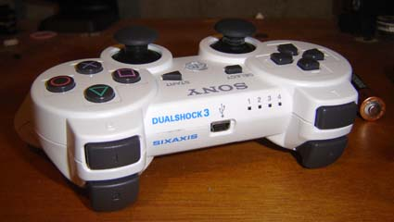
Motivation
Readily accessible and slightly inexpensive device
Similarities between this device and our project: Vibration Motors
Highly integrated embedded system
Future work: Bluetooth

Slide 3
Overview of the PS3 Controller
DualShock 3
Weight: 192g
Dimensions: 6.20 in × 3.78 in × 2.20 in
Bluetooth V2
Functioning

Slide 4
Tech Specs
Power: 3.7 V 300 mA (lithium batteries) or 5.0 V at 500mA (USB powered)
Motion sensing: 6-axes sensing (tri-axis accelerometer and tri-axis gyroscope)
2× Analog sticks (10-bit precision)
2× Analog triggers
6× Pressure-sensitive buttons
Pressure-sensitive directional buttons
5× Digital buttons
2x Vibration motors
Toshiba microprocessor with Bluetooth stack

Slide 5
Schematics

Slide 6
Dissecting the PS3 Controller

Slide 7
Dissecting cont’d

Slide 8
Keypad Contact

Slide 9
Identifying Mechanical Components

Slide 10
Understanding the Board (top)

Slide 11
Understanding the Board (bottom)

Slide 12
Summary of Dissection

Slide 13
Individual Components

Slide 14
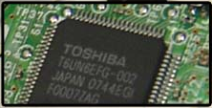
PCB Elements
Microprocessor with Bluetooth Stack
SixAxis sensor

Slide 15
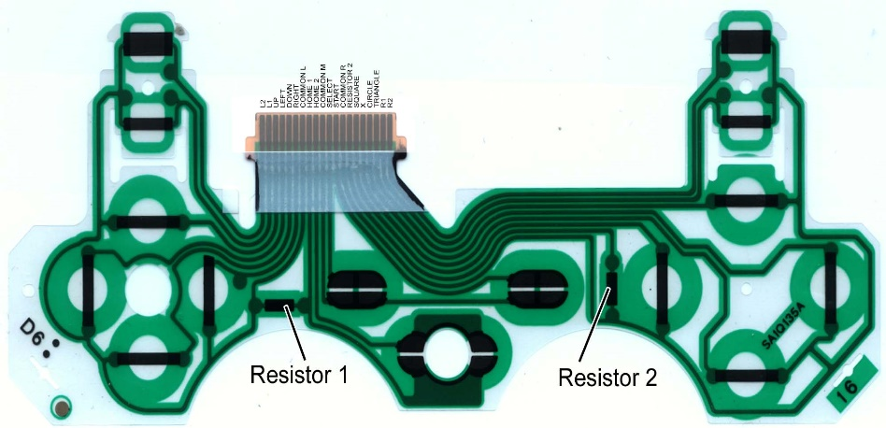
Other PCB Components
PCB Ribbon/Contact Pad
PCB

Slide 16
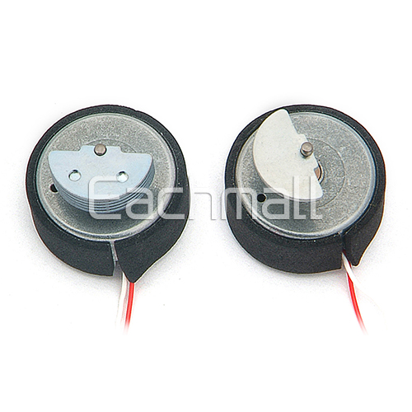
Mechanical Components
Analog Joysticks Potentiometers
Vibration Motors

Slide 17
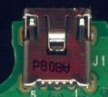
Power Components
Battery
USB

Slide 18
Other Components
Plastic Enclosure

Slide 19
Major Components
Component | Part # | Cost
Microprocessor w/Bluetooth Stack | T6UN6EFG-002 | $3.00
SixAxis Sensor | MPU 6050 | $4.06
PCB Ribbon/Contact Pad | SA1Q188A | $0.99
PCB | w400 94v-0 | < $14
Analog Joysticks | Ps3_3d | $1.59 each
Vibration Motors |  | $1.59
Lithium Battery | LIP1859 | $4.93
USB Hub | P8088 | $2.49
Plastic Enclosure |  | $3.79
 |  | $38.03

Slide 20
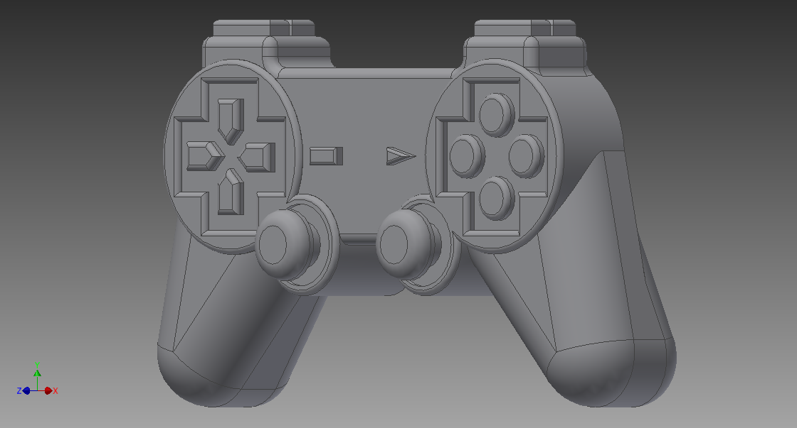
Component Sketches
Battery
Plastic Enclosure

Slide 21
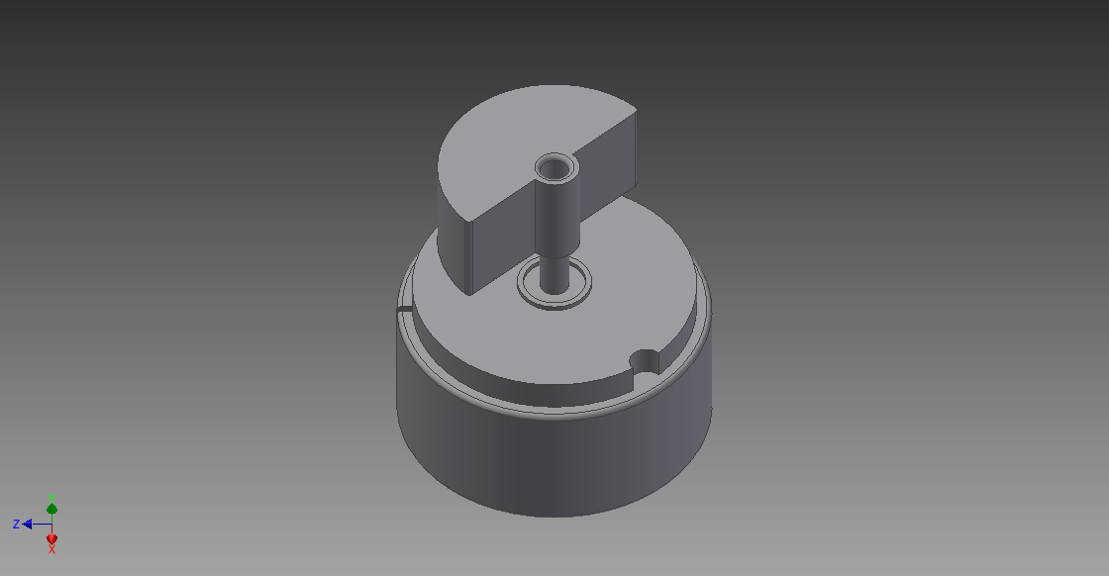
Component Sketches
Analog Joysticks Potentiometers
Vibration Motors

Slide 22
Component Sketches
SixAxis sensor

Slide 23
Conclusions
Useful for understanding the vibration motors
Excellent electrical engineering practice
Could not obtain useful information on the Bluetooth

Slide 24
References
http://www.scei.co.jp/corporate/release/070920be.html
http://benheck.com/03-22-2008/inside-the-dualshock-3-controller
http://www.ifixit.com/Guide/DualShock+3+Vibration+Motors+Replacement/3254
http://www.eachmall.com/goods-4936-4936.html?gclid=CPHa5_i4vbwCFSFo7Aod8D4Apw
http://www.engadget.com/products/sony/playstation/3/slim/specs/
http://www.acidmods.com/forum/index.php?topic=39591.0
https://www.youtube.com/watch?v=QzHn98xCBXI
http://www.isuppli.com/PublishingImages/Press%20Releases/2009-12-11_PS3_Contoller_Exploded.jpg
http://www.blogcdn.com/www.engadget.com/media/2007/04/buttgridlarge_engadget_howto.jpg

Slide 25
References cont.
http://www.amazon.com/Replacement-Battery-Sony-Playstation-Controller/dp/B003LJPT5S
http://www.cdiweb.com/ProductDetail/MPU6050-InvenSense-Inc-/422200/pid=568?gclid=CIm187G6vbwCFeVi7AodYwYADQ#.Uv_P-_ldXhB
http://www.ebay.com/bhp/ps3-controller-shell http://www.miniinthebox.com/popular/replacement-parts-for-ps3-controller.html

Slide 26
Questions?

